Slide 1
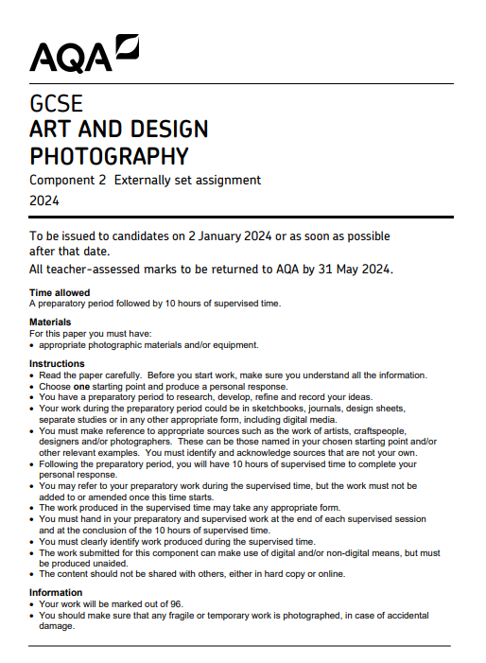
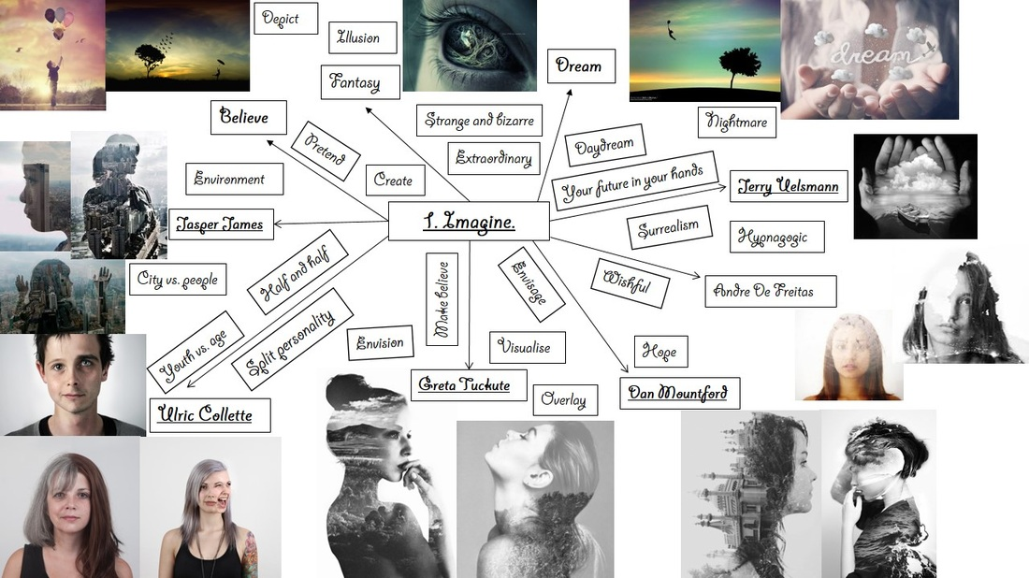
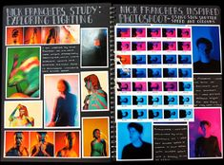
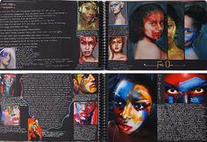
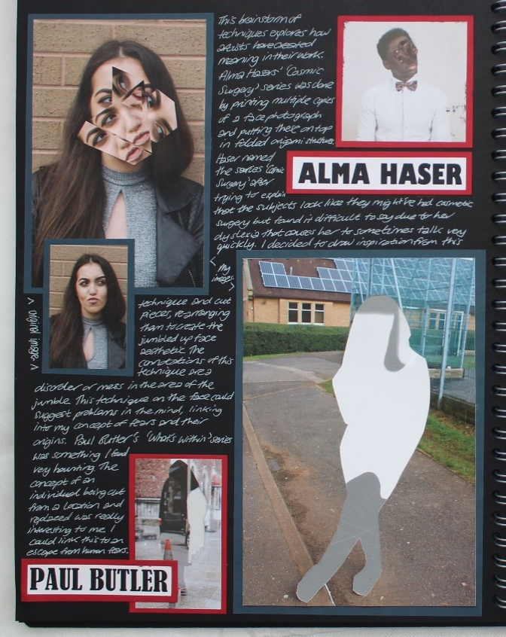
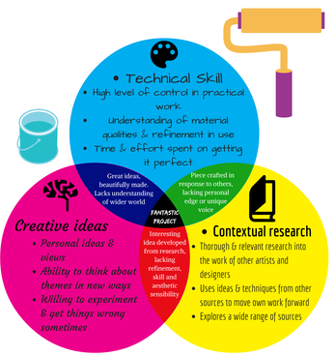

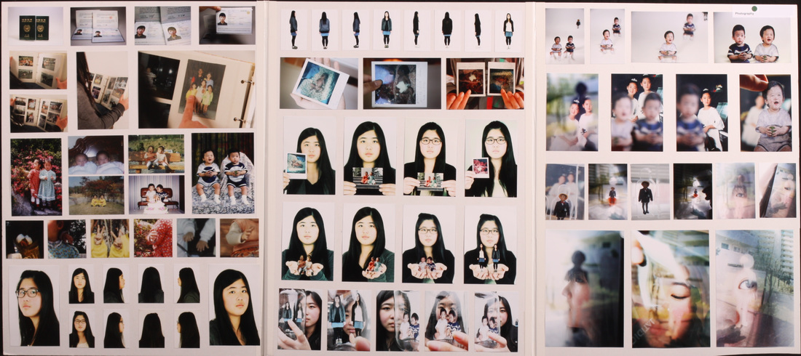
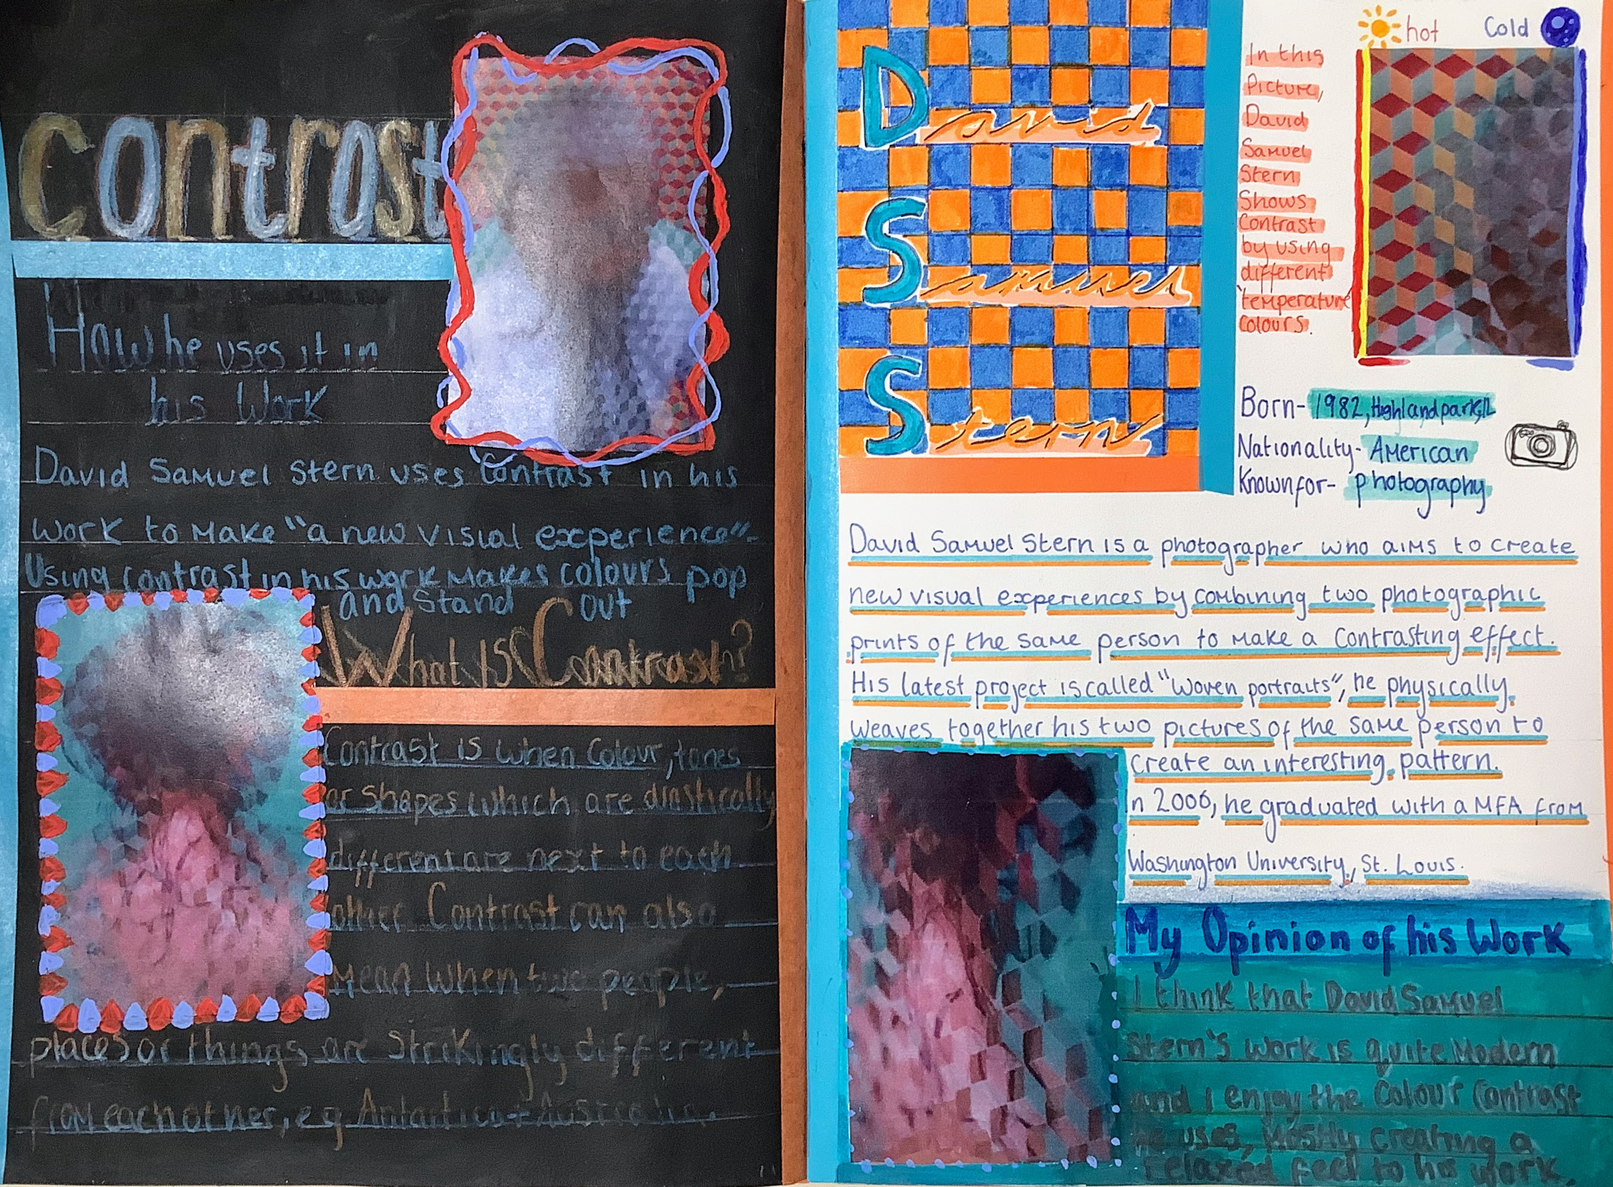
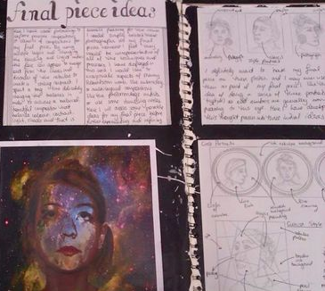
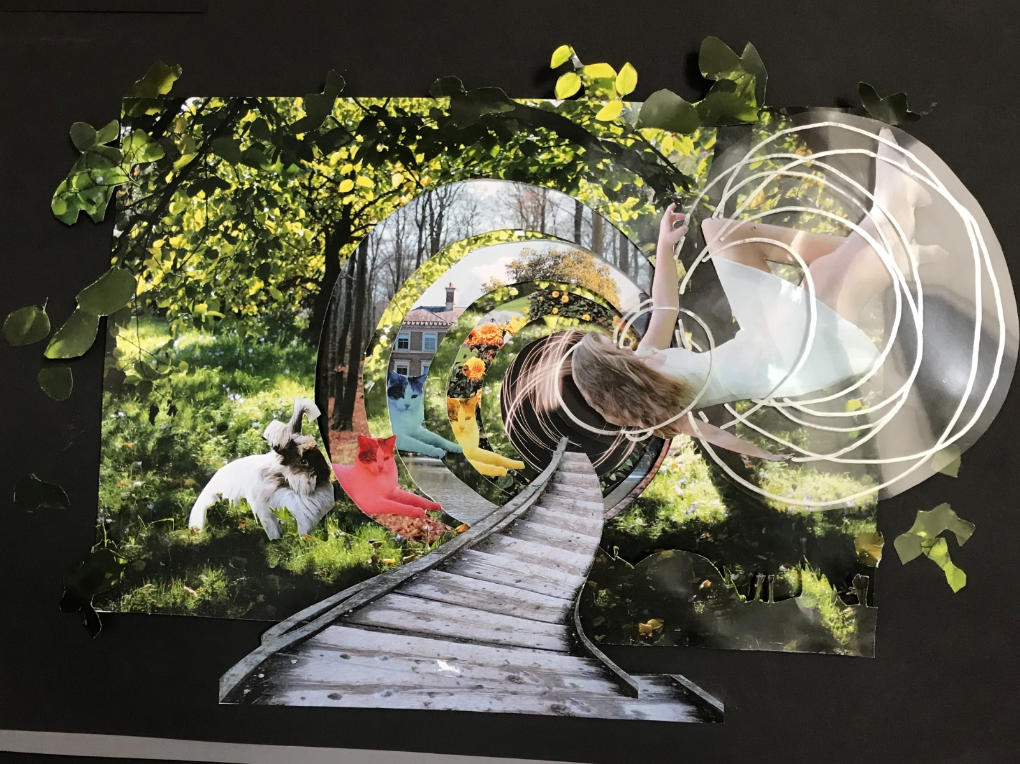
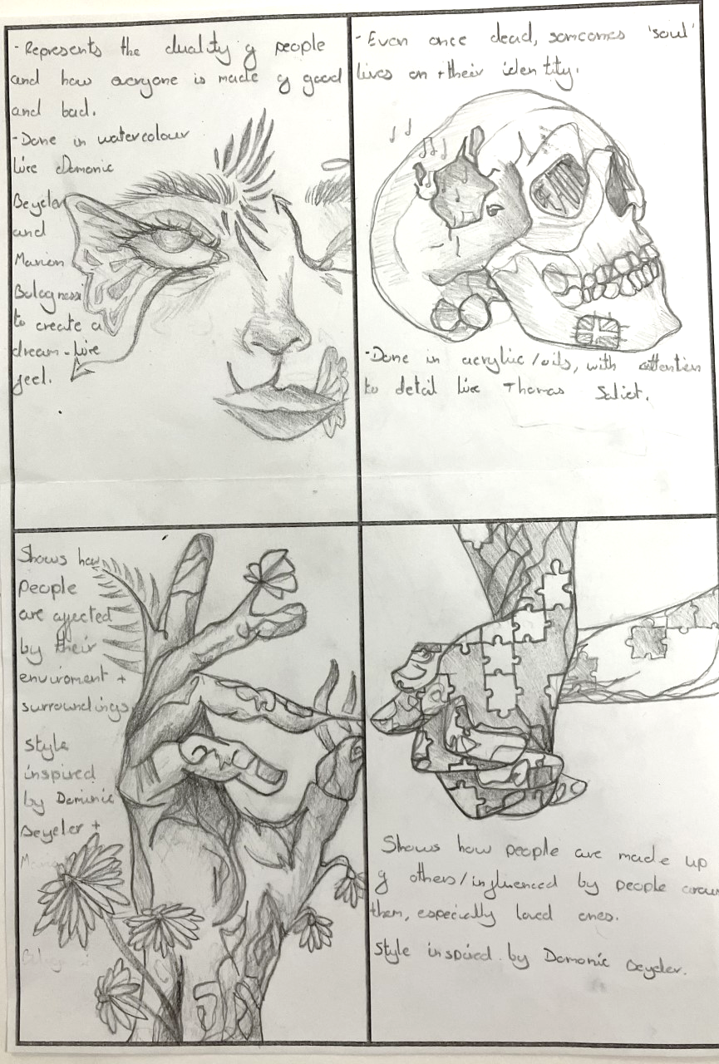
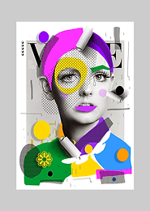
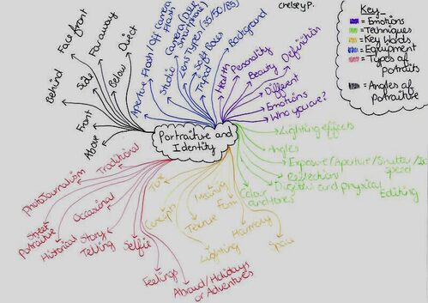
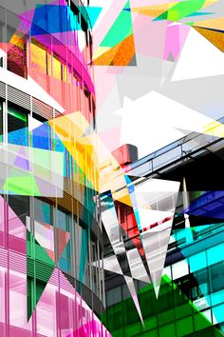
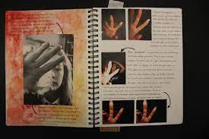
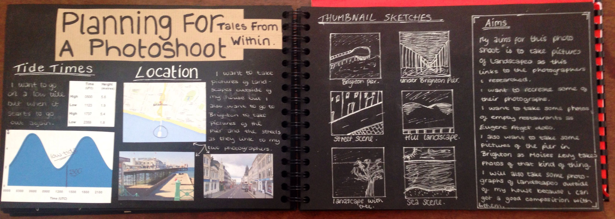
WEEK 1 - 6/1/25 Choose your question from the 7 on the paper | WEEK 1 - 6/1/25 Create a Mood board / Mind map of general ideas |  | WEEK 2,3,4 and 5 – 13/1/25 20/1/25 27/1/25 3/2/25 Create 3 double research pages on your chosen artists and create your own work based on these photographers (Mock exams will be in some lessons starting 3/2/25)
WEEK 6 – 10/2/25 Create a mind-map and/or a Venn diagram to compare the different artists/photographers (Mock exams will be in some lessons starting 3/2/25) | WEEKS 7 and 8 24/2/25 3/3/25 Take more photographs based on the ideas developed in the diagram – experiment in different ways | WEEK 9 and 10 10/3/25 17/3/25 Develop these ideas further | WEEK 11 24/3/25 Sketch out your ideas for your final piece and annotate these | WEEK 31/3/25 and the Easter break - Try out ideas for your final piece in different ways and write about these You will do the 10 hour final exam starting on the 28th April

