Slide 1
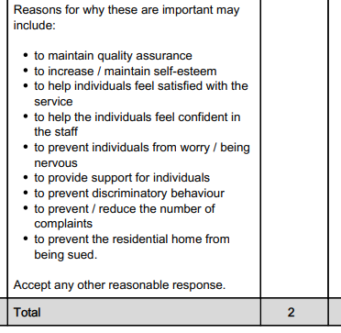
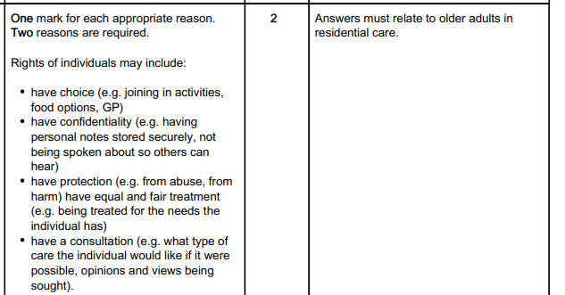
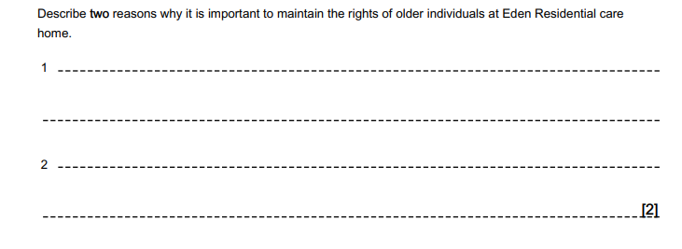
Do Now…

Slide 2
RO32: Principles of Care in Health and Social Care Settings
LO1 Revision

Slide 3
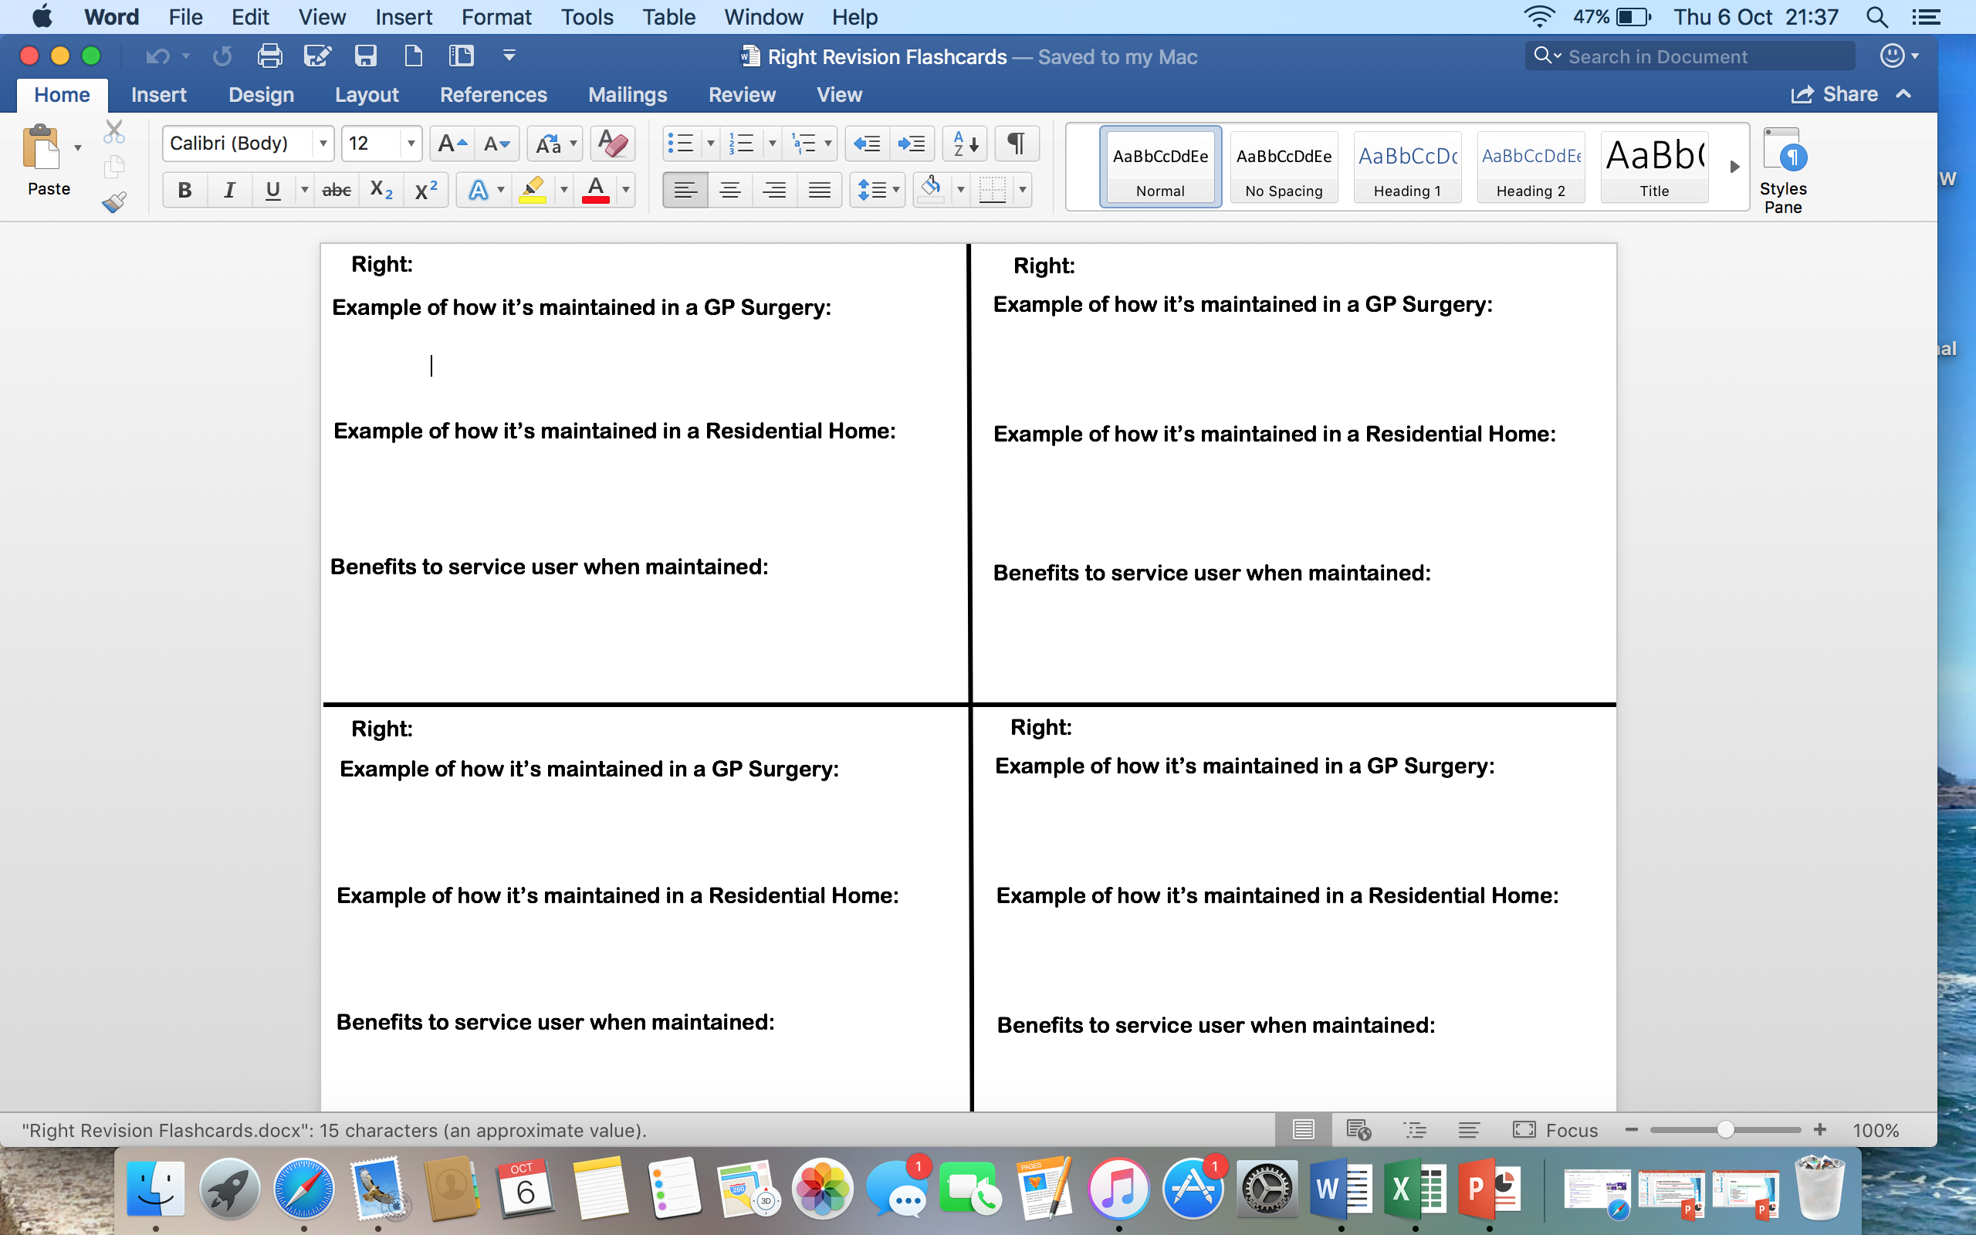
Rights…
What are the 5 Rights you need to know?
Choice
Confidentiality
Consultation
Protection from Abuse and Harm
Equal and Fair Treatment
Three Cs and a PE

Slide 4
How Service Providers Maintain Rights…
Task: For the exam, you need to know examples of how service users maintain Rights in a Health Care and Social Care setting. On your flashcards, write down in each Right an example of how they can be maintained in a GP Surgery (Health Care) and in a Residential Home (Social Care)
Lets discuss one as a class to start with to give an idea of what you need to write

Slide 5
The Benefits to Service Users When Rights are Maintained…
What are the 4 benefits when a service provider maintains individual’s Rights?
Empowerment:
Encourages independence and being self-reliant
Feeling in control of their lives
Gives service users choice, control and independence
Service users’ needs are met:
Appropriate care or treatment such as mobility aids provided, or dietary requirements met
Results in good/improving physical or mental health
Trust:
Reassured that service providers will not harm them
Confident that service providers have service users best interests in mind
Confident in the care they receive
High self-esteem:
Feeling valued
Feeling respected
Positive mental health

Slide 6
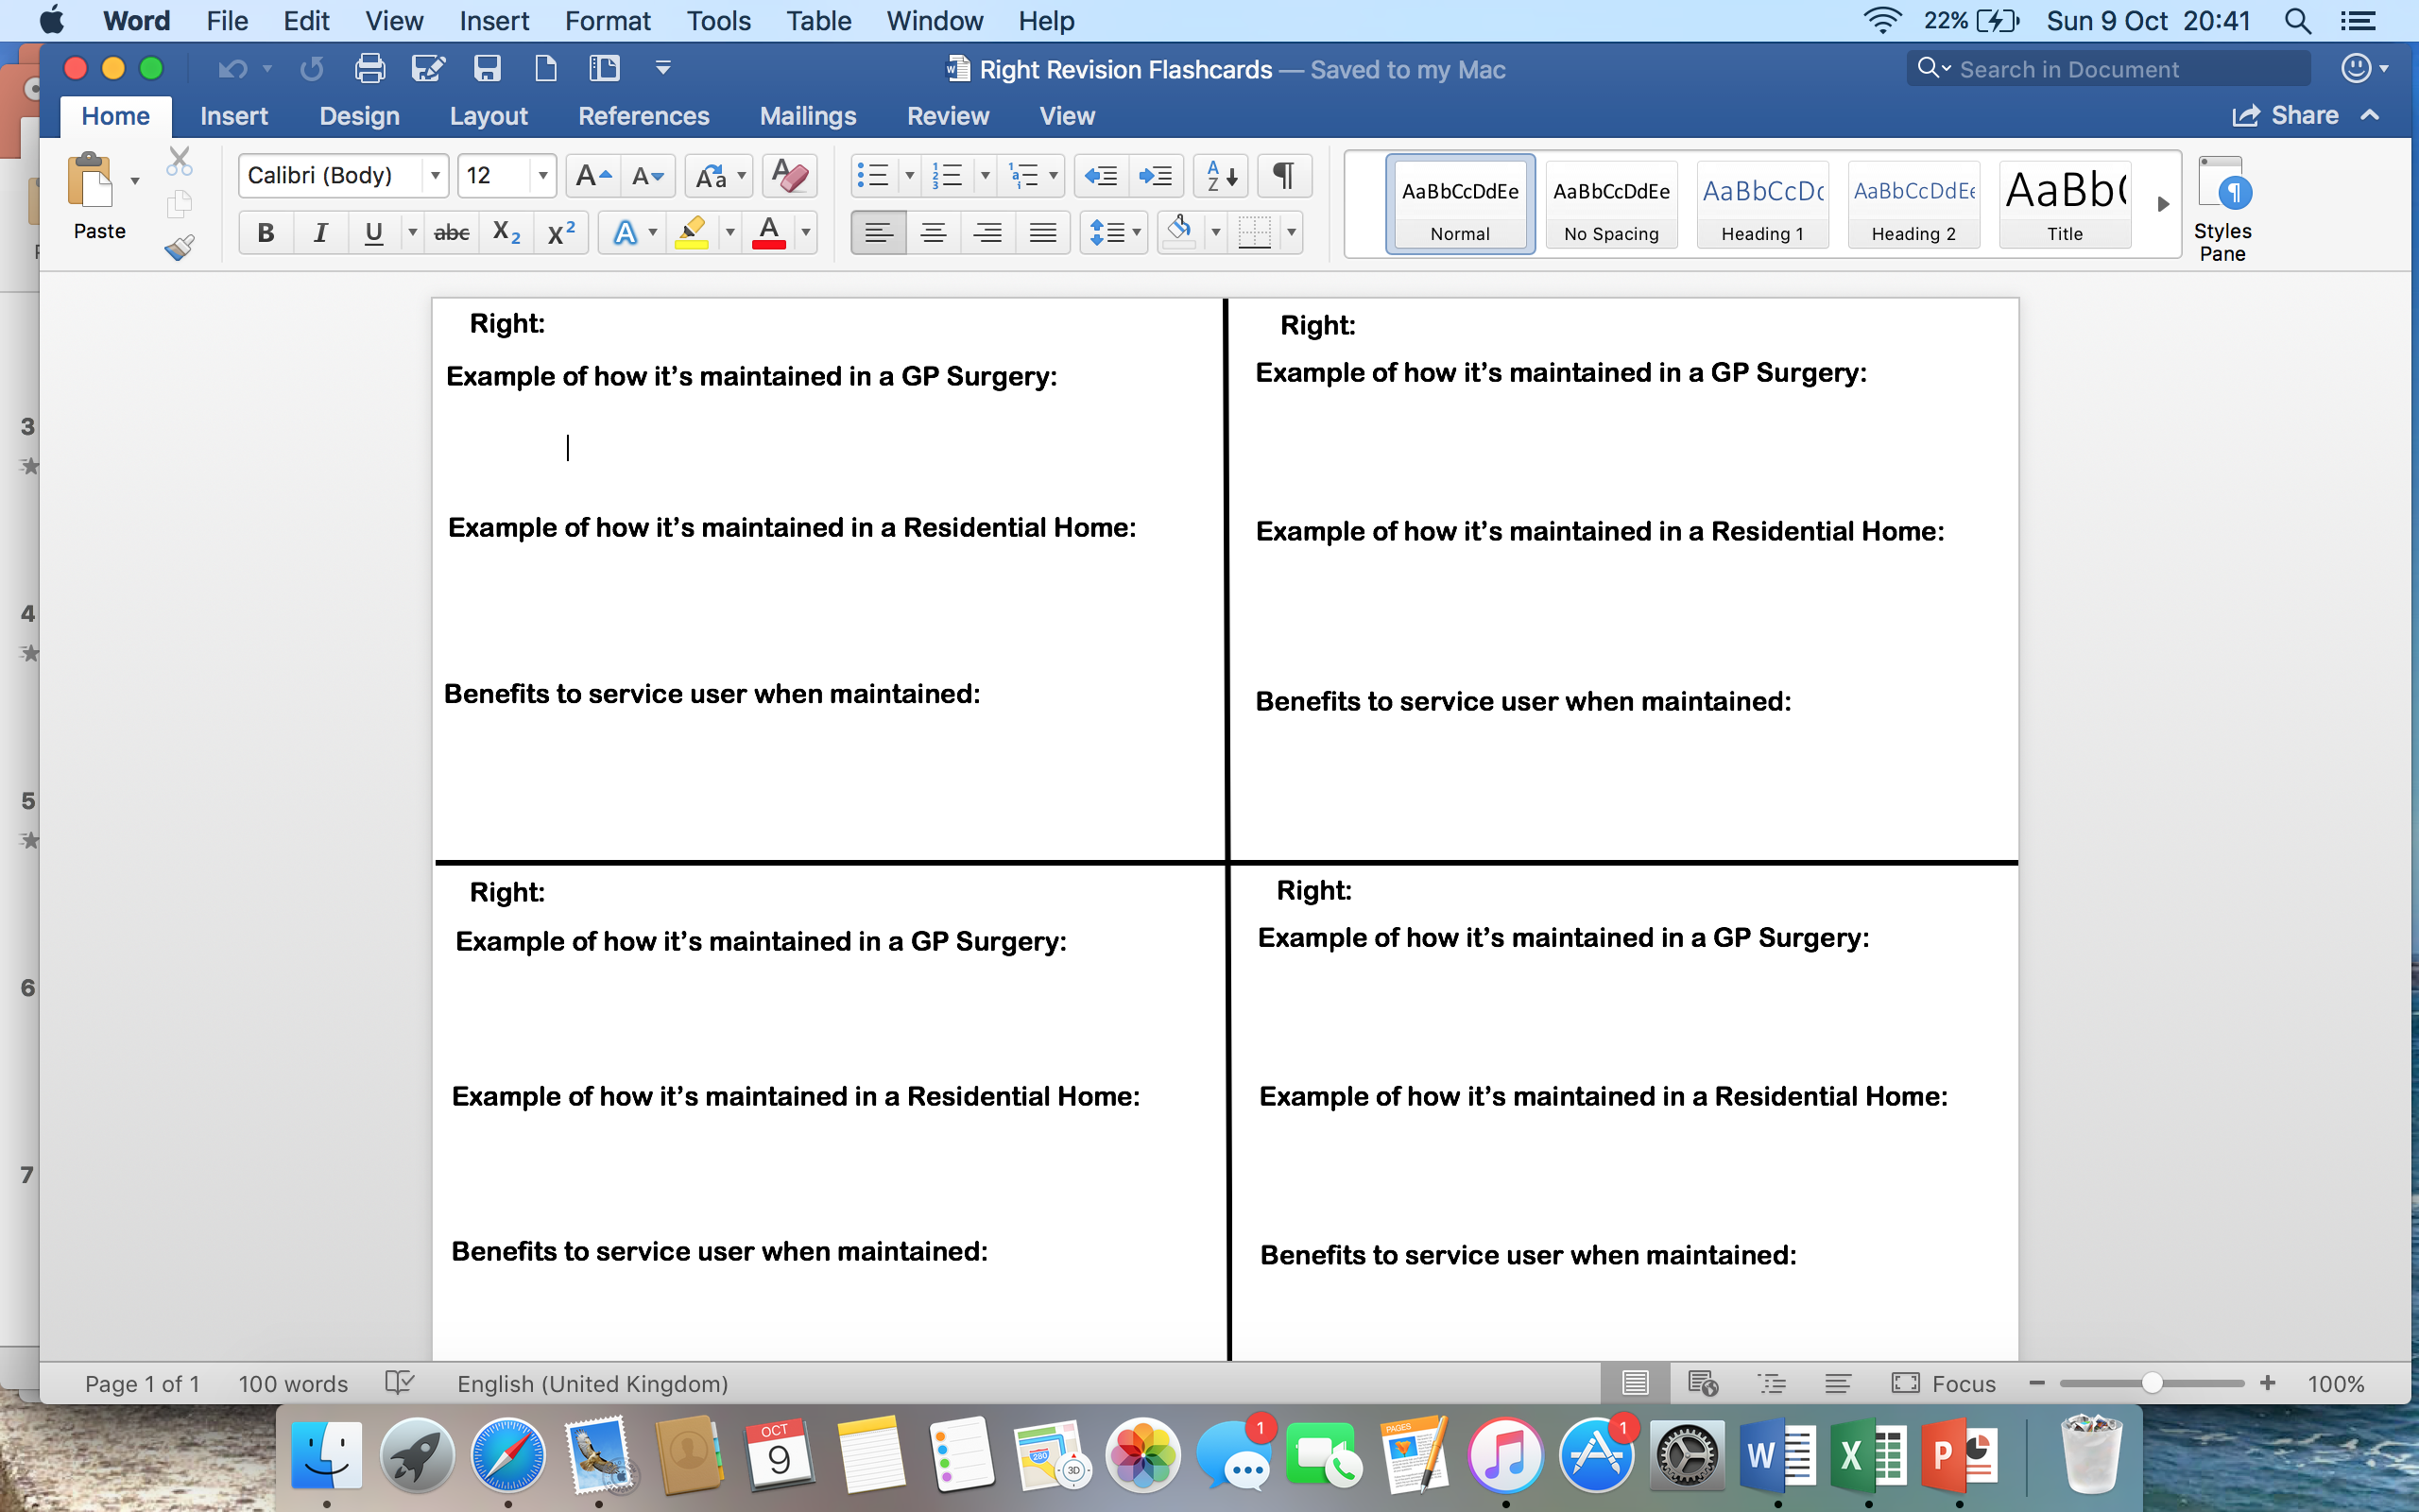
The Benefits to Service Users When Rights are Maintained…
Task: For the exam, you will need to give examples of the benefits service users will get when their Rights are maintained. On your flashcards, write down an example of a benefit a service user will receive when that Right is maintained.

Slide 7
Homework…
We have now completed all the content you need to know for the exams LO1 section. Next week, you will be having a End of Topic Test on all the things we have learnt about in this LO:
- Example of Health Care and Social Care settings
Rights
How Rights are maintained
The benefits to service users when Rights are maintained
Your Homework is to revise for this test.
Due: Monday 14th November

