Slide 1
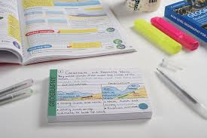


My teacher says 'revise'???

Slide 2

But how do I revise? What should I do?

Slide 3
Tips for Revision
The research on memory shows that we should start revising early and learn information little and often. The last thing to do is leave it all until it's too late and start cramming for the exam. If you try and revise everything all at once in one long session, you may feel great at first, but you will quickly forget it.

Slide 4
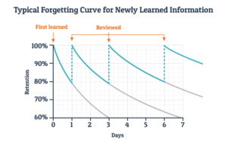
Forgetting things is natural and happens to everyone.
By revisiting material and doing this more often you can make a big difference to your memory.

Slide 5
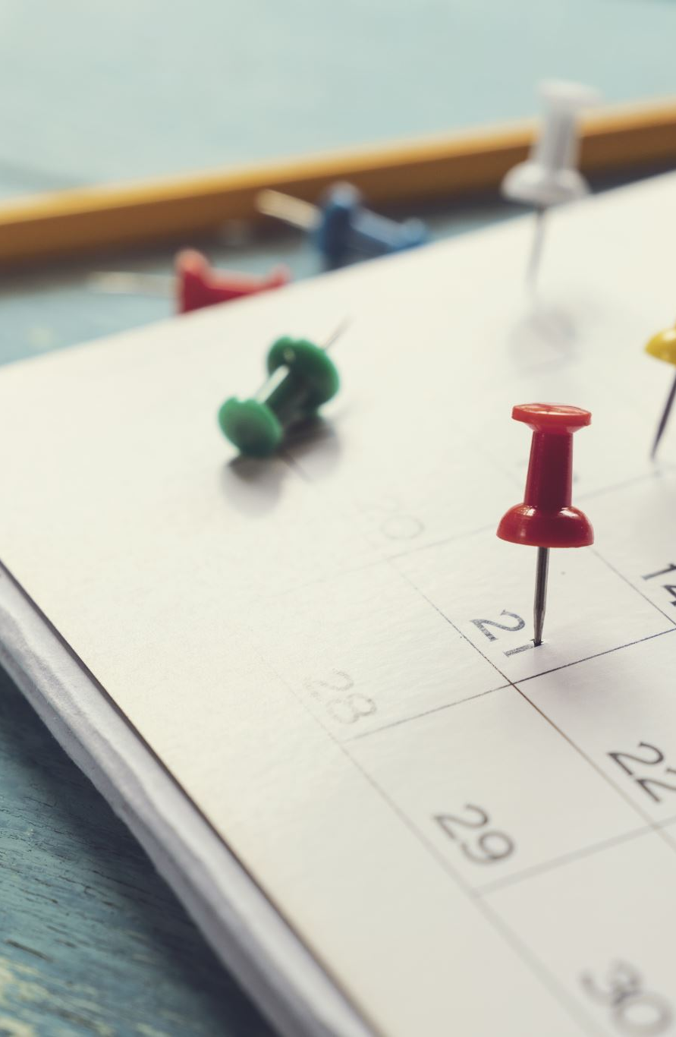
1. PLAN
Use the revision planner to map out your time. Plan to revise topics in 30 minute chunks.
Break down each subject into manageable topics. Your teachers will tell you the areas you are being assessed on.
Be realistic about how long each topic will take and mix up the subjects you learn each day.
Try not to revise the same topic for more than an hour.

Slide 6
Plan checklist:
30 minute chunks
No topic for more than 60 minutes
Be realistic and prioritise
Write them in the planner and tick them off

Slide 7

2. TAKE A BREAK
After each half an hour of revision, take a 5 minute break.
Your brain is like any other muscle in your body and it can only take on a certain amount of new information at once.

Slide 8

3. Strategies
Making sure that your revision sticks!

Slide 9
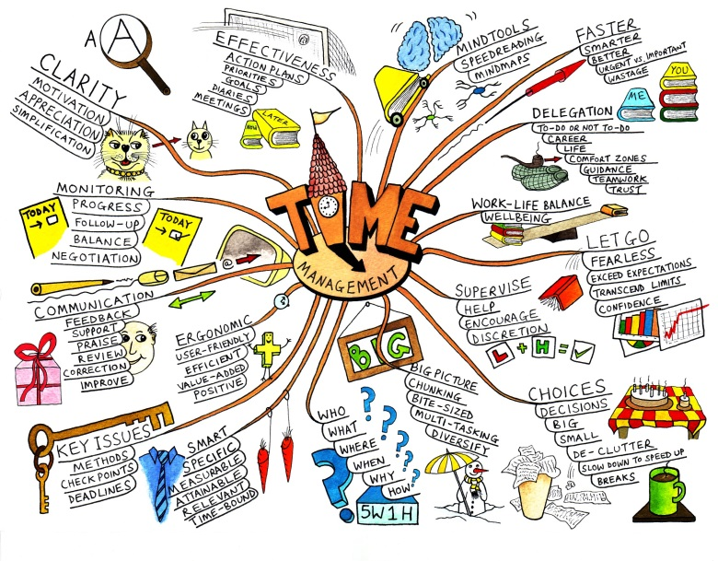
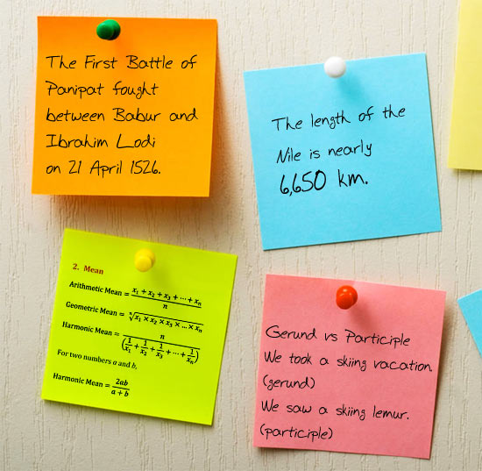
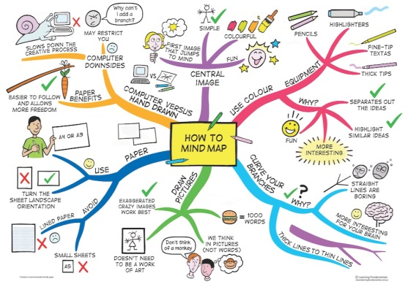
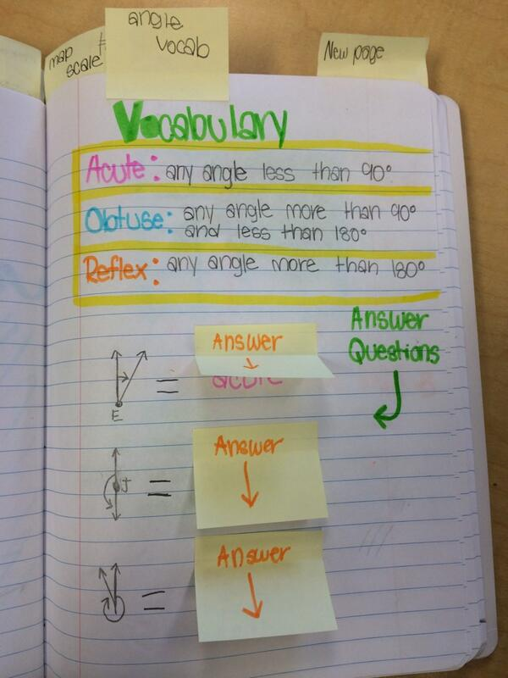
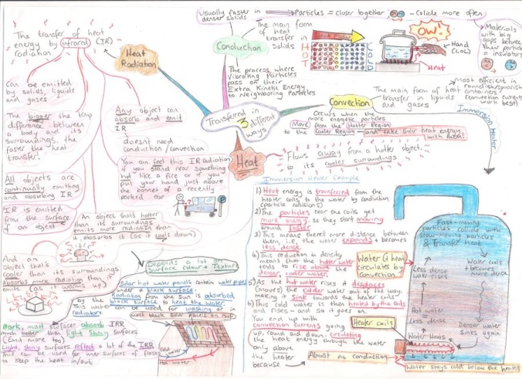
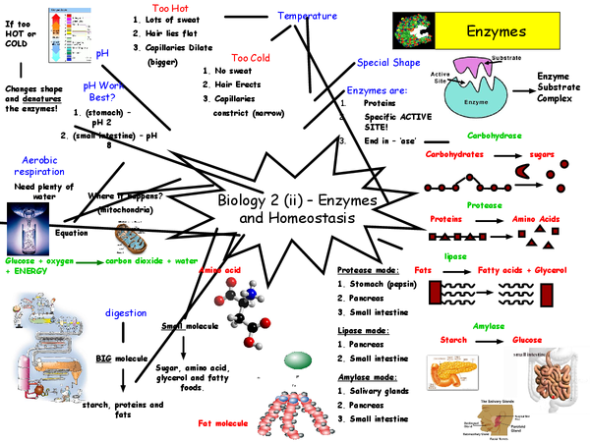
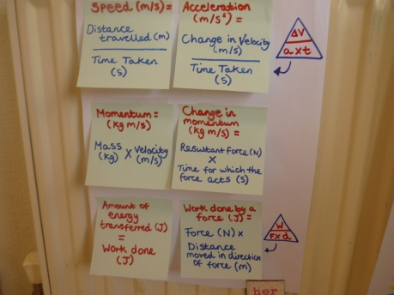
Revision skills

Slide 10
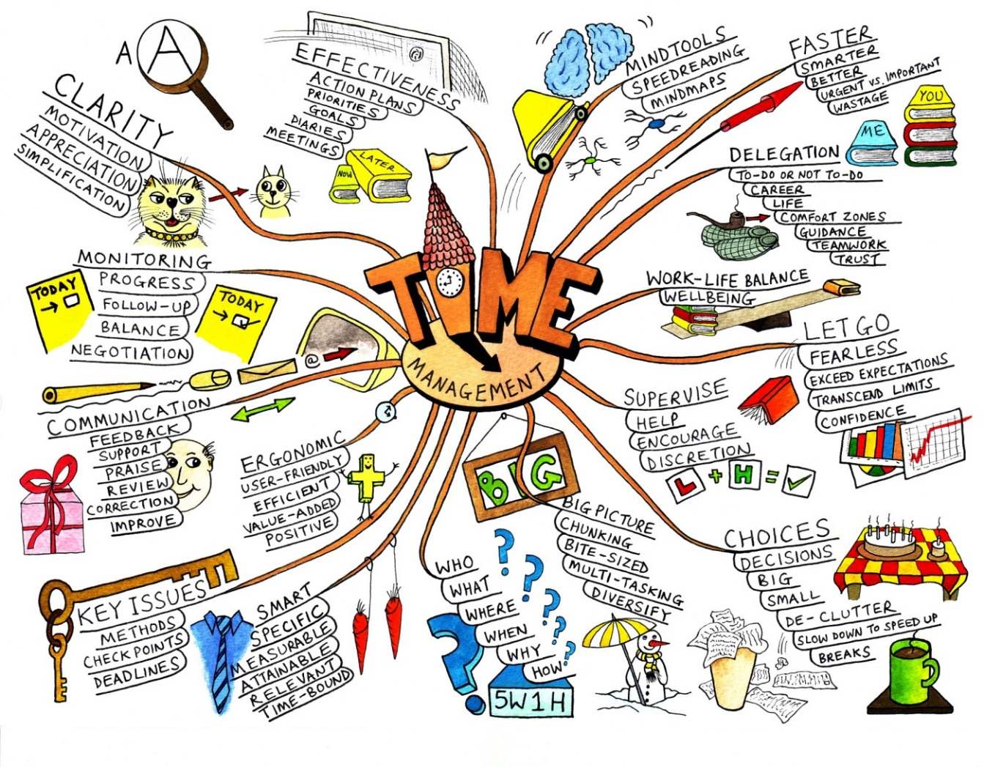
Strategy 1. Mind mapping
How do you use your class notes or revision guides to create revision notes in the form of a mind map?

Slide 11

Step 1. Create a central idea
Central idea is the topic you are going to revise.
It should be in the middle of your page and should include an image that represents the Mind Map’s topic to you.
Notes:
This helps you triggers to remember the topic as our brains respond better to visual prompts.

Slide 12

Step 2. Add branches to your map
Branches represent key factors or themes.
Add more detail to each by adding smaller branches.
Remember, the structure of your Mind Map will come naturally as you add more ideas.

Slide 13
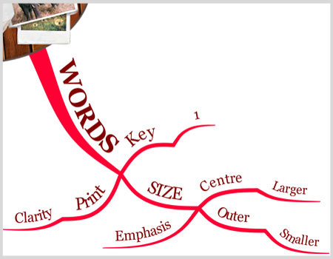
Step 3.
Add keywords
Each branch on your Mind Map, represents a key idea.
Try using one word per branch as this sparks off a more associations compared to using multiple words or phrases.
One word per branch also works well for chunking information into core topics and themes.
The use of keywords triggers connections in your brain and allows you to remember a larger quantity of information.
Notes:
An example of using one word per branch: if you include ‘Birthday Party’ on a branch, you are restricted to just aspects of the party. However, if you simply use the keyword ‘Birthday’, you can radiate out and explore the keyword, party, but also a wide variety of different keywords such as presents, cake etc.

Slide 14

Step 4. Colour code your branches
Colour coding helps your brain to create mental shortcuts.
Colours also make images more appealing and engaging, so you are more likely to remember.

Slide 15

Step 5. Include images
Images can say much more information than a word, sentence or even an essay.
They are processed instantly by the brain and act as visual stimuli to recall information.

Slide 16
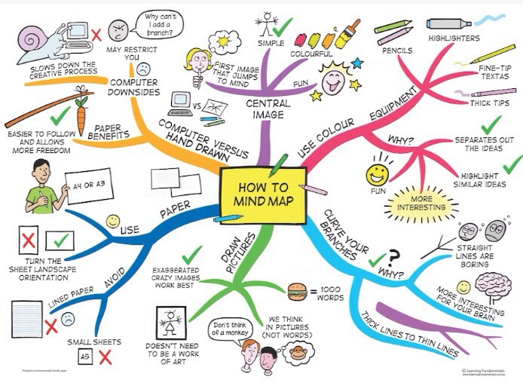

Slide 17
Research has shown:
1. starting early enough
&
2. Testing yourself
or
getting friends and relatives to test you
Successful revision =

Slide 18
How can I learn the information on my mind map using a 'foldable'?
Get a piece of A3 or A4 paper & fold it in to quarters.
Study your mind map for 1 minute.
Turn the mind map over so you cant see it
Use a clean face of the foldable to write as much as you can remember in one minute.
Count up how many facts you remembered & write this number in a circle on that side of your paper.
Now Repeat stages 2-5, at least two more times, or until you remember all the facts.

Slide 19
Strategy 2. Using Post it notes for revision

Slide 20
Using Post-it Notes or Flash Cards
Pick out key phrases that you need to remember & write them down on sticky notes or flash cards.
Write definitions on the other side
Post/place your notes somewhere you can see them
Pick a post-it note or card at random – test yourself, do you know the definition?
If not read it and repeat it back to yourself.

Slide 21
THIS BIT IS REALLY IMPORTANT
Just looking at the revision notes – whatever type of notes you use, will not be enough to remember the information.
YOU MUST:
TEST YOURSELF ON THE INFORMATION
OR
GET YOUR FRIENDS TO TEST YOU
OR
GET YOUR RELATIVES TO TEST YOU

Slide 22
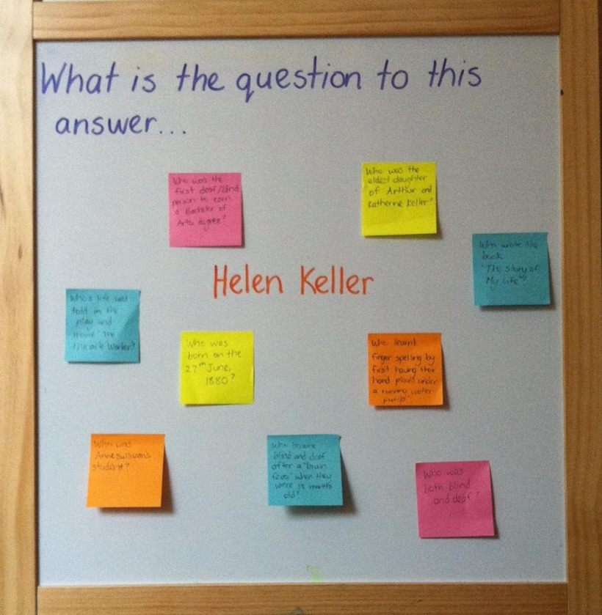

Notes:
Another way of using post-it notes to test yourself

Slide 23
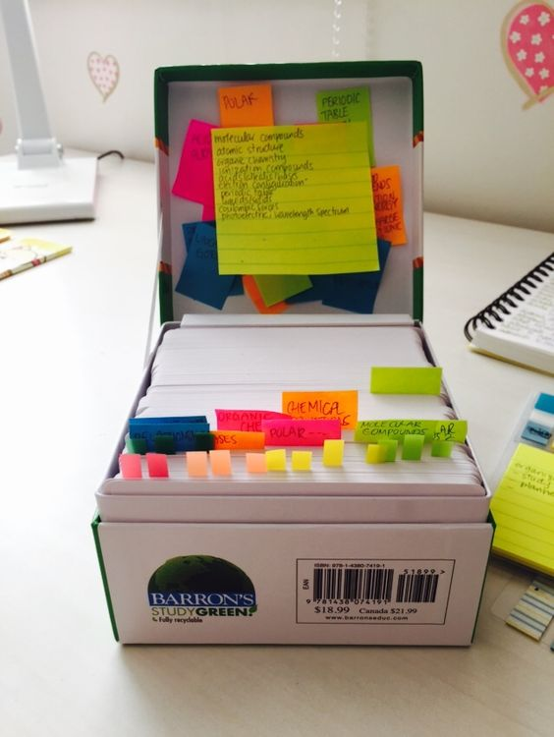

Strategy 3. Revision Roulette
Using Flash cards to revise
Otherwise known as the Leitner box of Flash cards
Step 1: Get decks of flash cards, multi-coloured if preferred.
If using coloured cards you could use one colour for each topic.
Step 2: find a suitable sized box to place them in
Step 3: For each topic create an index card with a different factor that is covered by the topic.
Have the title on one side of the card or at the top

Slide 24
You must do something with the information – it needs effort
Step 4: To make your flash cards, look through your notes and select out the key points. DON'T just copy out your notes! YOU need to reduce to key words or transform the information into something else.
Summarise the key points, use buzz words or symbols, highlighters and different colours.
Variety in presentation and use of symbols can act as triggers to remember more detail later.
The next slide gives you an idea of what this might look like

Slide 25
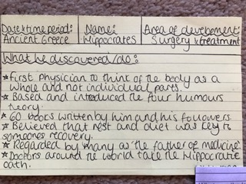
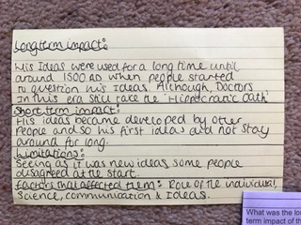
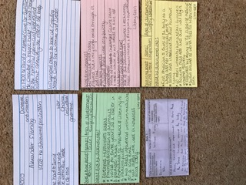

Slide 26
If there's a lot to remember, divide your cards into three sections:
Section 1 Red Zone
From this section pick out each card to self quiz on regularly (every day).
Pick the card at the front of the section
This box will contain all the flash cards that contain information that you feel you need to practice often as you make mistakes in them.
After each practice, if still not mastering it, place it at the back of section 1.
When you feel that you have mastered the knowledge you can move this card to the back of section 2.

Slide 27
Section 2: Amber Zone
Section 2 The Amber Zone
From this section pick out each card to self quiz in a few days time.
Pick the card at the front of the section first
This box will contain all the flash cards that contain information that you feel you are starting to remember most of it, but are still not confident.
After each practice, if still not mastering it, place it at the back of section 2.
When you feel that you have mastered the knowledge you can move this card to the back of section 3.

Slide 28
Section 3: Green Zone
Section 3 The Green Zone
From this section pick out each card to self quiz less often (after a few days).
Pick the card at the front of the section first
This box will contain all the flash cards that contain information that you feel you have mastered and can remember fully.
After each practice, if you are still feeling confident, place it at the back of section 3.
If you think that you have started to forget the content after 10 days – move it back up the back of box 2 & start the process again.

Slide 29

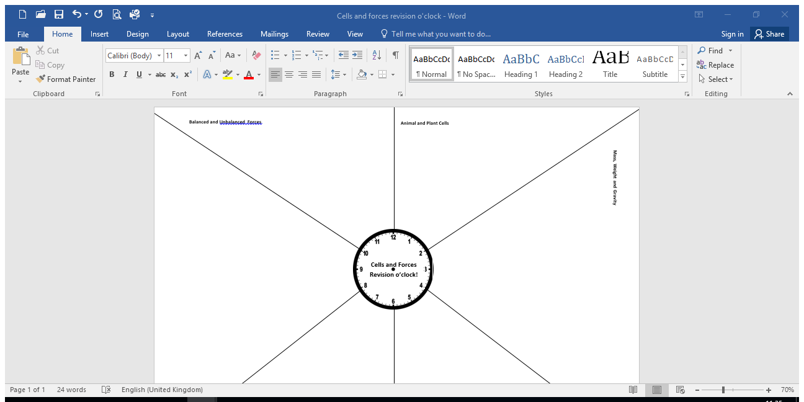
Strategy 4 'Revision o’clock’.
All you need is a piece of paper a pen, your brain and your exercise book/revision booklet.

Slide 30
This technique will help you condense your notes-so less to learn.
You are forced to use your memory so you can find out what you are already know and what you need to work on.
If you find getting started hard or managing time difficult this technique should help you.

Slide 31
Find the page that look like this.
Each section represents a topic.
You have 5minutes to fill this section in from memory.
You can use colour and diagrams

Slide 32
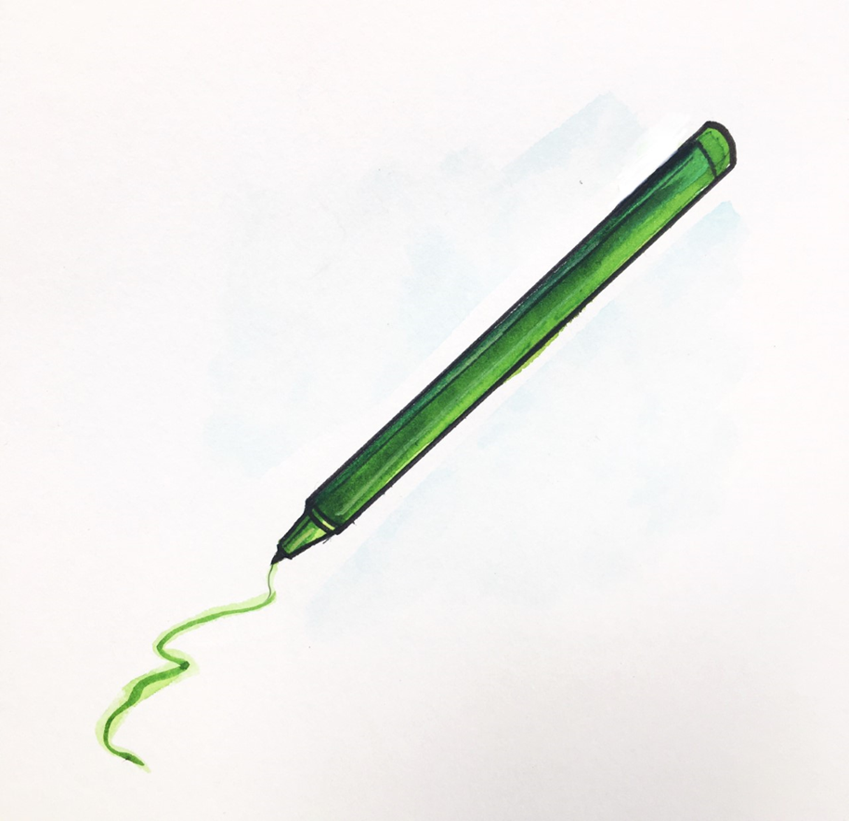
Once you have completed a section of your ‘revision clock’. Use your notes/revision guide or knowledge organiser to check, correct and complete it.
Use green pen for corrections, so you know what you are less confident about.
5 minutes

Slide 33
Repeat the process for different topics and complete another section.
5minutes from memory
Then use your green pen and spend another 5minutes making improvements

Slide 34
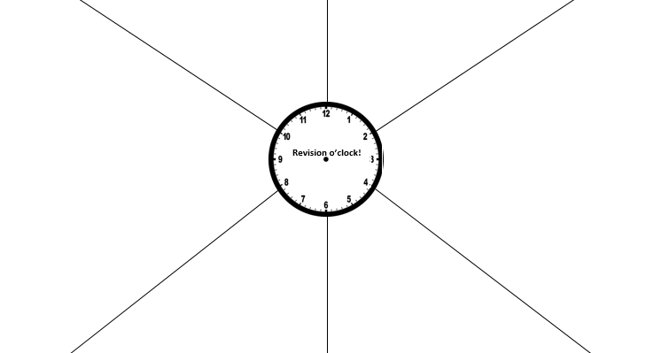
We will upload a blank template and all the resources in a revision area on the website (You can easily create one with a blank sheet – you don't really need a clock!)
This is so you can pick 6 areas of your own and complete them at home using this method.

Slide 35
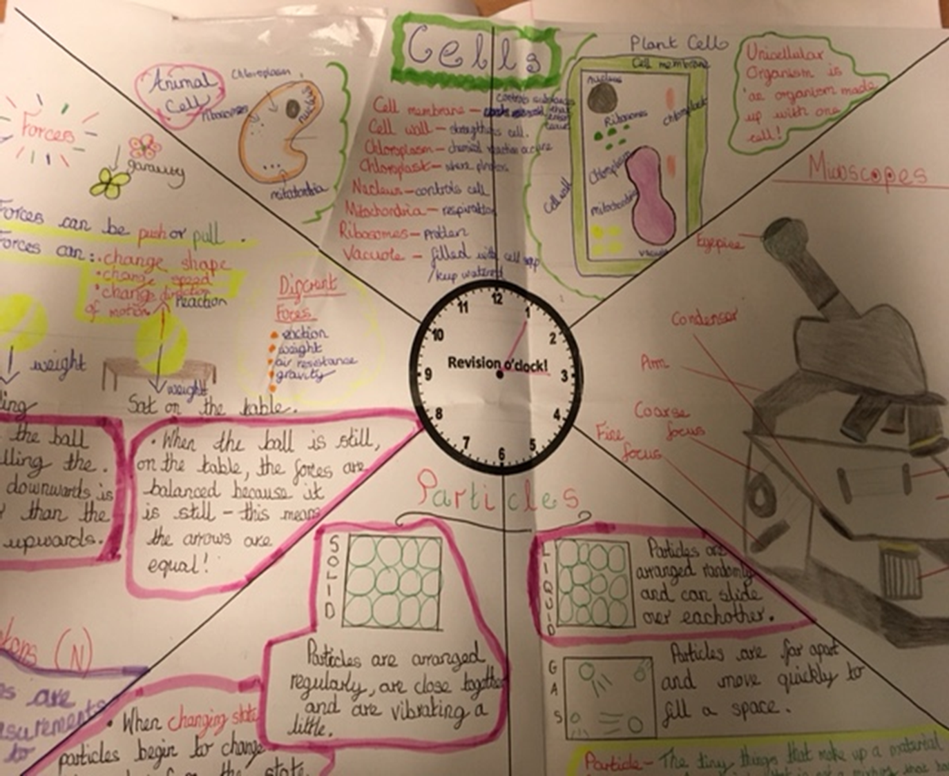
There have been some fantastic revision o'clocks produced in the past.
Do bring any in to show your teachers

Slide 36
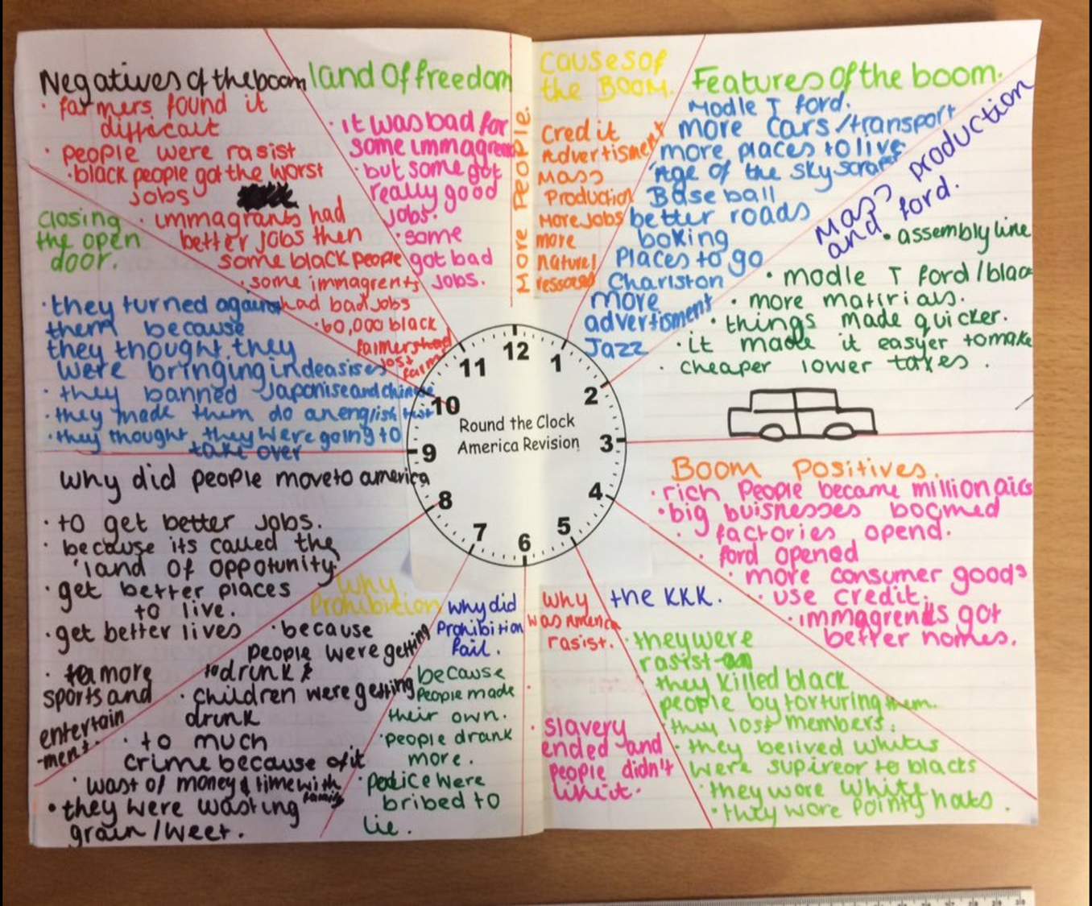
You can use it in any subject.

Slide 37
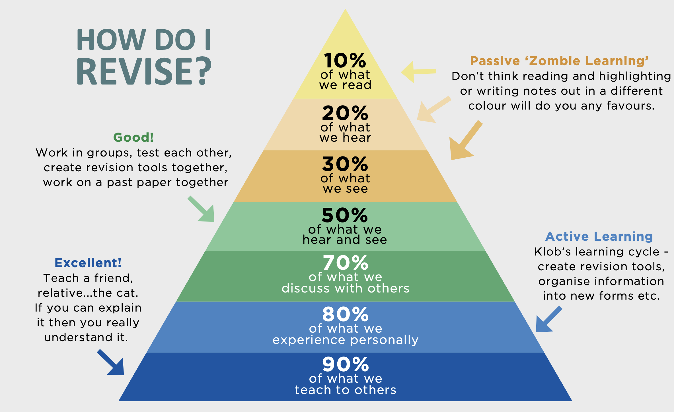
Why do these strategies work?

Slide 38

4. Remember to Test yourself

Slide 39
Test yourself.
Get family and friends to test you.
Complete exam questions and past papers.
Use the mark schemes.
Use your teachers.

Slide 40

5. Don’t fool yourself
If you are revising, make sure this is the only thing you are doing. Avoid...

Slide 41
One eye on sky planner/Netflix
Constantly checking alerts on your phone
Shuffling/Choosing your songs on your airpods
FIND YOUR SPACE – find a quite space that is dedicated for you to work.

Slide 42

6. Relax
Visualise what success will look and feel like once you have completed your End of Year exams

Slide 43
Have a life. The planner is divided into sections. You are not supposed to fill every section with revision.
Eat well, drink plenty of water, plan times that you will exercise, socialise, spend time with friends and family. This is all part of your plan.
If you follow this advice, you will be doing your absolute best. No one can ask more than that! And remember...

Slide 44


